Slide 1
A STATISTICAL APPROACH TO MACHINE TRANSLATION
Author : Peter F. Brown
Professor : 陳嘉平
Repoter : 楊治鏞

Slide 2
Outline
Introduction
The language model
The translation model
Searching
Parameter estimation
Two pilot experiments
Plans

Slide 3
Introduction(1/3)
The field of machine translation is almost as old as the modern digital computer.
We feel that it is time to give statistical methods a chance in machine translation.

Slide 4

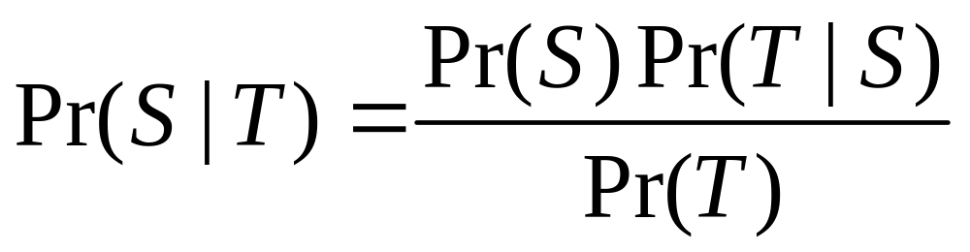
Introduction(2/3)
We know that our chance of error is minimized by choosing that sentence S that is most probable given T. Thus, we wish to choose S so as to maximize . Using Bayes’ theorem, we can write

Slide 5


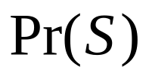

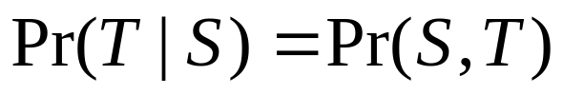

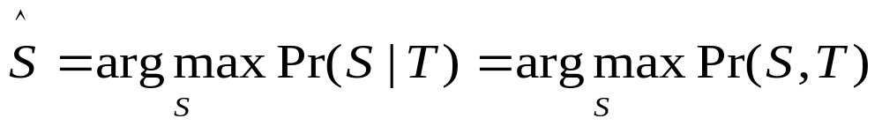
Introduction(3/3)
Source
Language
Model
Translation
Model
Decode

Slide 6
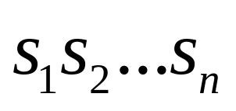
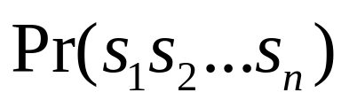
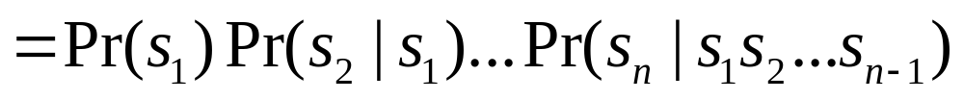
The language model
Given a word string,
n-gram model
We can see the power of a trigram model by applying it to something that we call bag translation from English into English.
bigram
trigram

Slide 7
Bag translation
In bag translation we take a sentence, cut it up into words, place the words in a bag, and then try to recover the sentence given the bag.
Exact reconstruction (24 of 38)
Please give me your response as soon as possible.
Please give me your response as soon as possible.
Reconstruction preserving meaning (8 of 38)
Now let me mention some of the disadvantages.
Let me mention some of the disadvantages now.
Garbage reconstruction (6 of 38)
In our organization research has two missions.
In our missions research organization has two.

Slide 8
The translation model
For simple sentences, it is reasonable to think of the French translation of an English sentence as being generated from the English sentence word by word.
We refer to a picture such as that shown in Figure 3 as an alignment.
An alignment indicates the origin in the English sentence of each of the words in the French sentence.

Slide 9
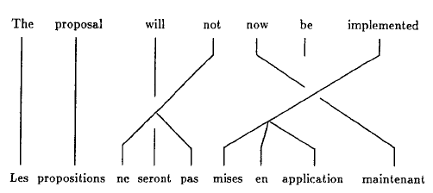
Figure 3

Slide 10
Fertility and distortion
We call the number of French words that an English word produces in a given alignment its fertility in that alignment.
Sometimes, a French word will appear quite far from the English word that produced it. We call this effect distortion.

Slide 11
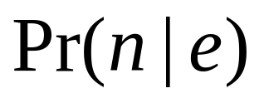


Fertility probabilities
for each English word and for each fertility from 0 to some moderate limit, in our case 25.

Slide 12
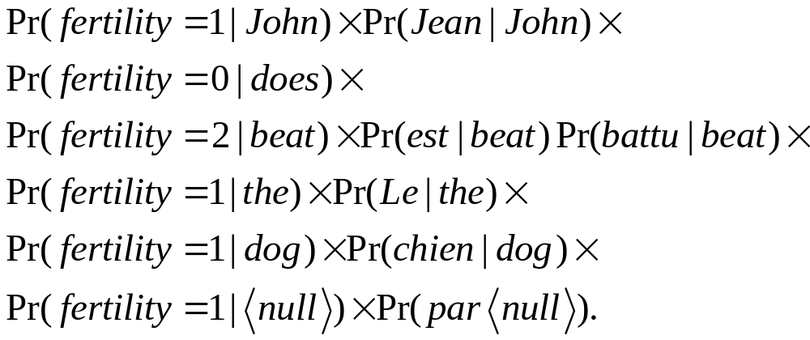
Fertility and translation
(Le chien est battu par Jean | John(6) does beat(3,4) the(1) dog(2) )

Slide 13
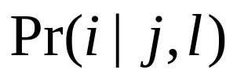



Distortion probabilities
We assume that the position of the target word depends only on the length of the target sentence and the position of the source word.
where is a target position, a source position, and the target length.

Slide 14

Searching
In searching for the sentence S that maximizes , we face the difficulty that there are simply too many sentences to try.
Using a variant of the stack search
(Jean aime Marie |*)
where the asterisk is a place holder for an unknown sequence of source words.

Slide 15
Searching
The search proceeds by iterations, each of which extends some of the most promising entries on the list.
An entry is extended by adding one or more additional words to its hypothesis.
The search ends when there is a complete alignment on the list that is significantly more promising than any of the incomplete alignments.

Slide 16
Example
We might extend the initial entry above to one or more of the following entries:
(Jean aime Marie |John(1)*),
(Jean aime Marie |*loves(2)*),
(Jean aime Marie |*Mary(3)),
(Jean airne Marie |Jeans(1)*).

Slide 17
Parameter estimation
Hansards
We could estimate the parameters of the translation model by counting.

Slide 18
Parameter estimation
Given some initial estimate of the parameters, we can compute the probability of any particular alignment.
We can then re-estimate the parameters by weighing each possible alignment according to its probability as determined by the initial guess of the parameters.
Repeated iterations of this process lead to parameters that assign ever greater probability to the set of sentence pairs that we actually observe.

Slide 19
Two pilot experiments
In our first experiment, we test our ability to estimate parameters for the translation model.
Hansards
9,000 most common words
40,000 pairs of sentences
Comprising 800,000 words

Slide 20
First experiment
Figure 4 shows the translation and fertility probabilities we estimated for the English word the.

Slide 21
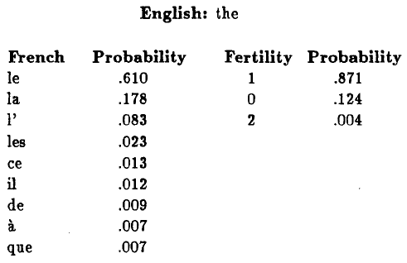
Figure 4

Slide 22
First experiment
In some sense, this correspondence is inherent in the sentence pairs themselves.
Figure 5 shows these probabilities for the English word not.
In Figure 6, we see the trained parameters for the English word hear.

Slide 23
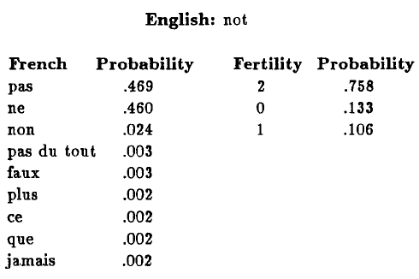
Figure 5

Slide 24
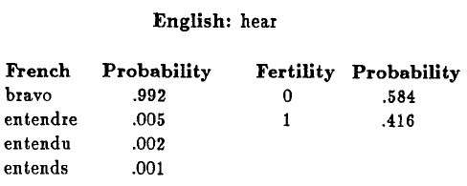
Figure 6

Slide 25
Second experiment
We used the statistical approach to translate from French to English.
Hansards
English vocabulary: 1,000 words
French vocabulary: 1,700 words

Slide 26
Model
Translation model
  Sentences: 117,000
Bigram language model
  Sentences: 570,000
  Words: 12 million

Slide 27
Category
Exact
Alternate
Different
Wrong
Ungrammatical

Slide 28
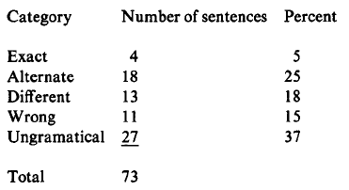
Translation Results

Slide 29
Translation Results
As an alternate measure of the system's performance, one of us corrected each of the sentences in the last three categories (different, wrong, and ungrammatical) to either the exact or the alternate category.
776 strokes
This compares with the 1,916 strokes required to generate all of the Hansard translations from scratch.
the system reduces the work by about 60%.

Slide 30
Plans
Expect
Problems
Trigram language model
Morphologies

